Slide 1
E-commerce WINKLE
Task - 3

Slide 2

E-commerce WINKLE
"Winkle is a dynamic e-commerce platform, reimagining online shopping for a global audience. With an extensive product catalog, seamless transactions, and a vibrant community, Winkle connects buyers and sellers in a user-friendly digital marketplace, making every purchase an experience."
LMS Username | Name | Batch
au111420205014 | HEPZIBAH CATHERINE F | CA10
au111420205036 | RISHIKESH R | CA10
au111420205048 | TAMILSELVAN V | CA10
au111420205055 | YUVARAJ B | CA10

Slide 3
Task 3 :: Frontend Creation
Create various Front End Programs
Draw and design a uniform front end code for WINKLE
Draw and design a interactive front end code for WINKLE
Evaluation Metric:
100% Completion of the above tasks
Learning outcome
Developing complicated UI using HTML components
Using props drilling and context to pass variables
Getting familiar with different type of api calls
Handling different input data

Slide 4
Step-Wise Description
Step 1: Project Setup
Begin by creating the project structure using a front-end framework such as React. Utilize tools like `create-react-app` to kickstart the development environment and establish the necessary dependencies.
Step 2: HTML Components
Break down the UI into reusable HTML components like ProductList, ProductCard, Cart, and CheckoutForm. Each component should handle a specific aspect of the UI, promoting modularity and maintainability.
Step 3: Props Drilling
Implement props drilling to facilitate the passage of data between components. For example, pass product information from the ProductList component to individual ProductCard components using props, ensuring efficient data flow.
Step 4: Context for Global State
Integrate context to manage global state, such as user authentication or shopping cart items. Create a context provider to wrap your components, allowing for a centralized state management system.

Slide 5
Step-Wise Description
Step 5: API Calls
Incorporate API calls to fetch data from the backend server. Utilize libraries like axios or fetch for seamless communication. For instance, create a ProductService to handle fetching product data from the API endpoint.
Step 6: Handling Input Data
Implement forms and input components to manage user input effectively. For example, create a SearchForm component to handle search queries, enabling users to interact with the website efficiently.
Step 7: Putting It All Together
Combine the created components, context providers, API calls, and input handling to construct the complete e-commerce website. Adjust the details based on your project requirements and chosen technologies, ensuring a cohesive and functional user interface.

Slide 6
Summary of your task
To construct a sophisticated e-commerce website UI, start by setting up the project using React and essential tools. Break down the UI into reusable HTML components like ProductList and ProductCard, ensuring a modular structure. Implement props drilling to facilitate seamless data flow between components. Utilize context for global state management, handling aspects like user authentication and shopping cart items. Integrate API calls through libraries like axios to fetch data from the backend, and design forms like SearchForm for effective user input. Finally, combine all components, context providers, API calls, and input handling to create a cohesive and functional e-commerce website. Adjust details as needed based on project requirements and chosen technologies.

Slide 7
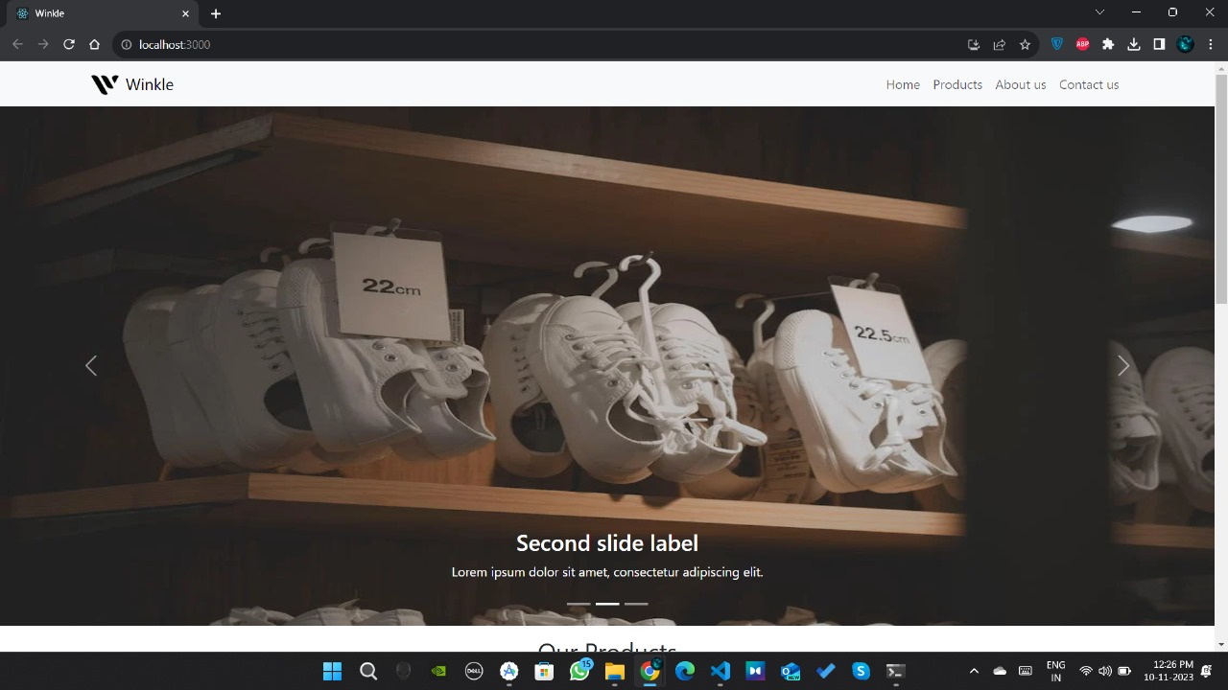
OUTPUT

Slide 8
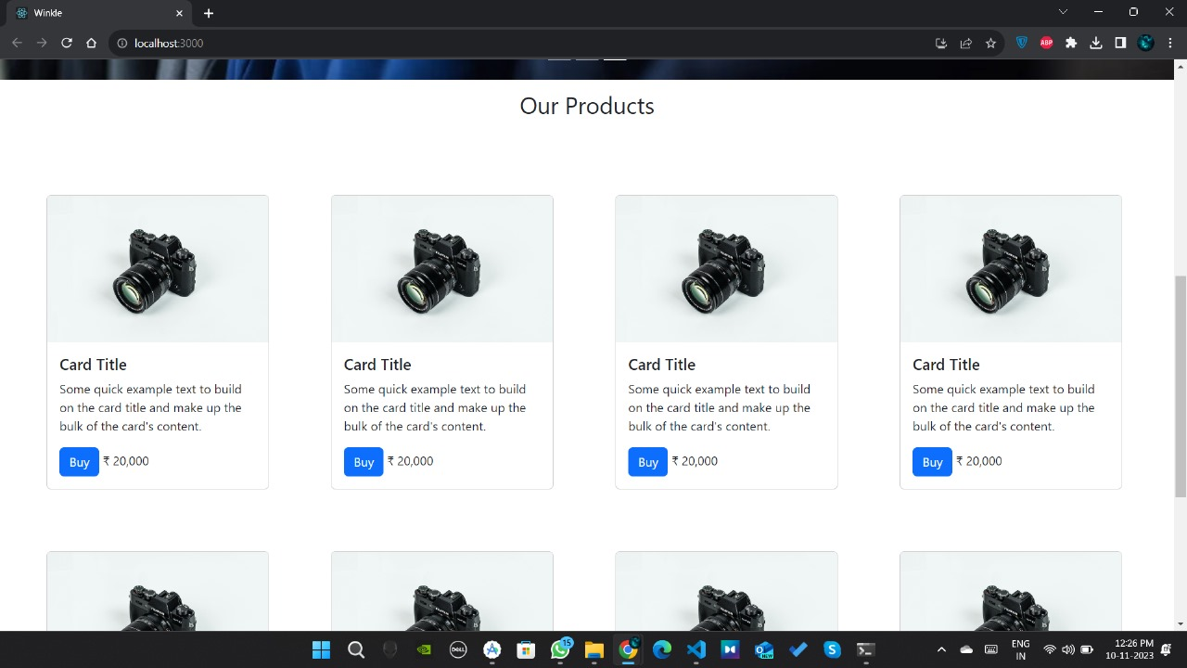
OUTPUT

Slide 9
Submission Github
https://github.com/Rishi963/Naanmudhalvan-FSD-PEC-CA10

